Slide 1
Messaging Technologies
Group: Yuzhou Xia
Yi Tan
Jianxiao Zhai

Slide 2
IBM MQSeries

Slide 3
IBM MQSeries
What is it
- AKA IBM WebSphere MQ. A family of network software products launched by IBM in March 1992.
- A MOM that allows independent applications on a distributed system, even of dissimilar IT infrastructures to communicate. And it supports all the popular protocols.
- It provides reliable and asynchronized one-time delivery of messages.
- IBM MQSeries consists of three products:
MQSeries Messaging: provides the communication mechanism between applications on different platforms
MQSeries Integrator: centralizes and applies business operations rules
MQSeries Workflow which enables the capture, visualization and automation of business processes

Slide 4
IBM MQSeries
Components
- Queues:
A data structure to store messages that independent from the applications
It can be stored in local machines (local queue) or queue manager (remote queue)
Has properties that defines the available behaviour of application
Persistent and non-persistent messages
Message priorities, message notification
- Queue Managers:
Responsible for queues
Transfer messages from input to output queues
Keep routing tables
- Message Channels:
Reliable connections between queue managers

Slide 5
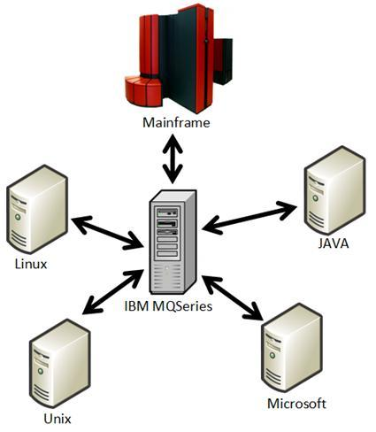
IBM MQSeries
Features
- Cross-platform
- Asynchronous
- Reliable
- Priority
- Routing available

Slide 6
JMS
Java Message Service

Slide 7
JMS Introduction
Introduction
- a set of interfaces and associated semantics (Sun Microsystems)
- provide a way for Java program to access an enterprise messaging system (MOM)
- support the messaging communication between computers
Objective
make Java application portable on any major operating system platform
- MOM vendor available in multiple languages, including the Java language
- JMS provides a standard, portable way to send and receive messages through a MOM

Slide 8
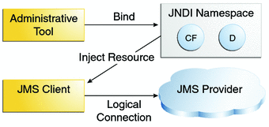
JMS Architecture
A JMS applications is composed of four parts:
- JMS provider: provide administrative and control features
- JMS client: produce and consume message
- Messages: objects that communicate information between JMS clients
- Administered Objects: JMS objects created by an administrator for the use of clients

Slide 9
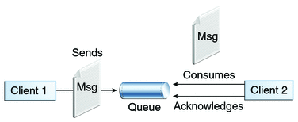
JMS Messaging Domain
Point-to-Point Messaging Domain
- each message is addressed to a specific queue
- receiving client extract messages from the queue
- no timing dependency between sender and receiver
- after that, the receiver will acknowledge the success

Slide 10
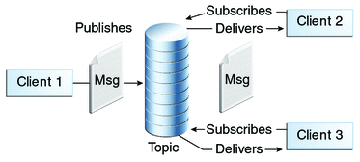
JMS Messaging Domain
Publish-Subscribe Messaging Domain
- client acts as a publisher will address messages to a topic
- clients act as subscribers will obtain messages from the topic
- both are generally anonymous and can dynamically publish or subscribe messages
- timing dependency between publishers and subscribers

Slide 11
JMS Advantages
- maximize the portability of messaging applications
- extend the power and flexibility of messaging products
- minimize the concept of a programmer must learn

Slide 12
Related Techniques

Slide 13
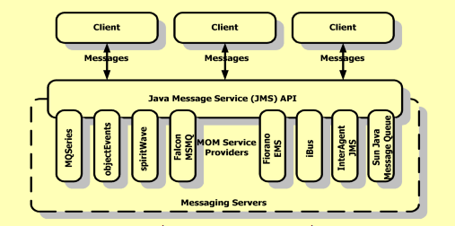
JMS & MQSeries
API & Messaging Middleware, like JDBC & DB2
JMS for Java(J2EE), MQSeries for multitype messages(Java, C, Perl)
JMS for multiple middleware, MQSeries for message publishment/subscription

Slide 14
Related Messaging Techniques
SOAP (Simple Object Access Protocol)vs JMS
Define similar message format ---- header,properties(key-value pairs with header),body
SOAP send in XML format, JMS send a flexible java object
SOAP for RPC(Remote procedure call), JMS for general message exchange
SOAP connects 2 points, JMS at least 3 points

Slide 15
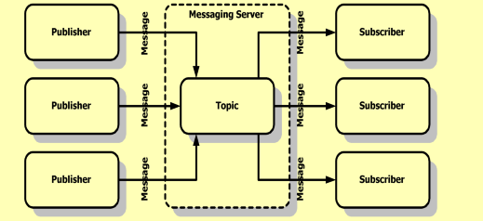
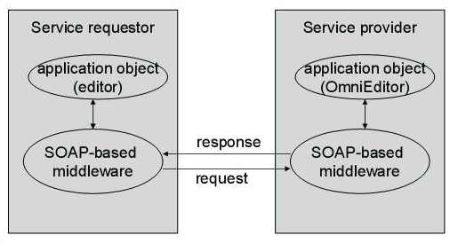
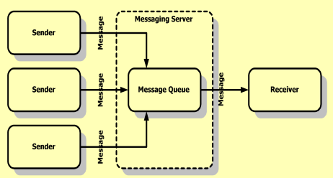
SOAP
JMS

Slide 16
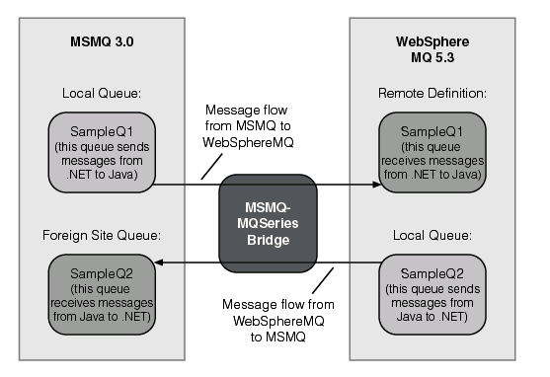
Related Messaging Techniques
Microsoft MSMQ vs IBM MQSeries
.NET (Windows-only) vs Multi Language(C, Java, Perl)
MSMQ-MQSeries Bridge
ship with Microsoft Host Integration
Server (HIS)
provide a bridge between MSMQ
& IBM WebSphere MQ
JNBridgePro & Ja.NET
both“loosely-coupled reusability
of business components”

Slide 17
Thank You

